Slide 1

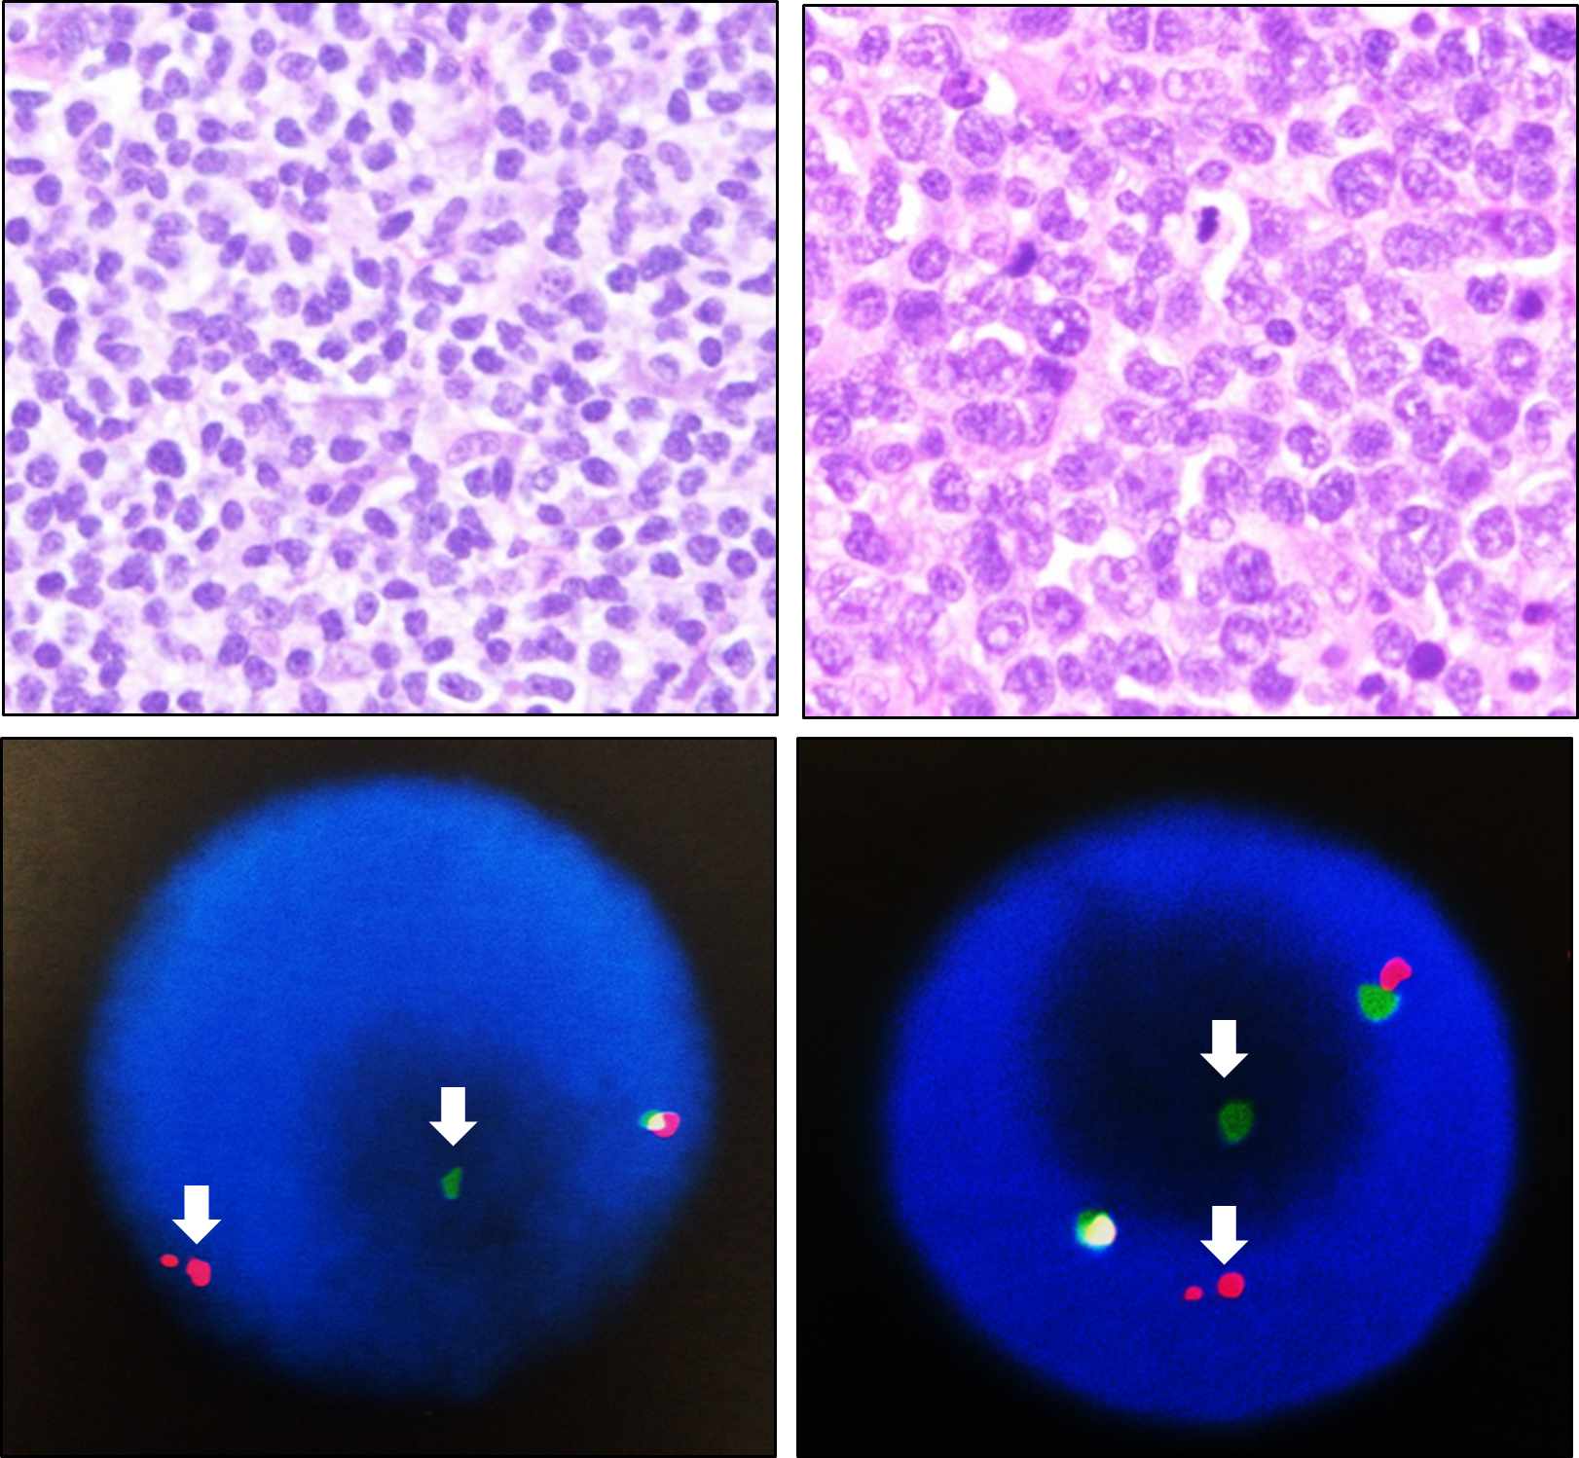


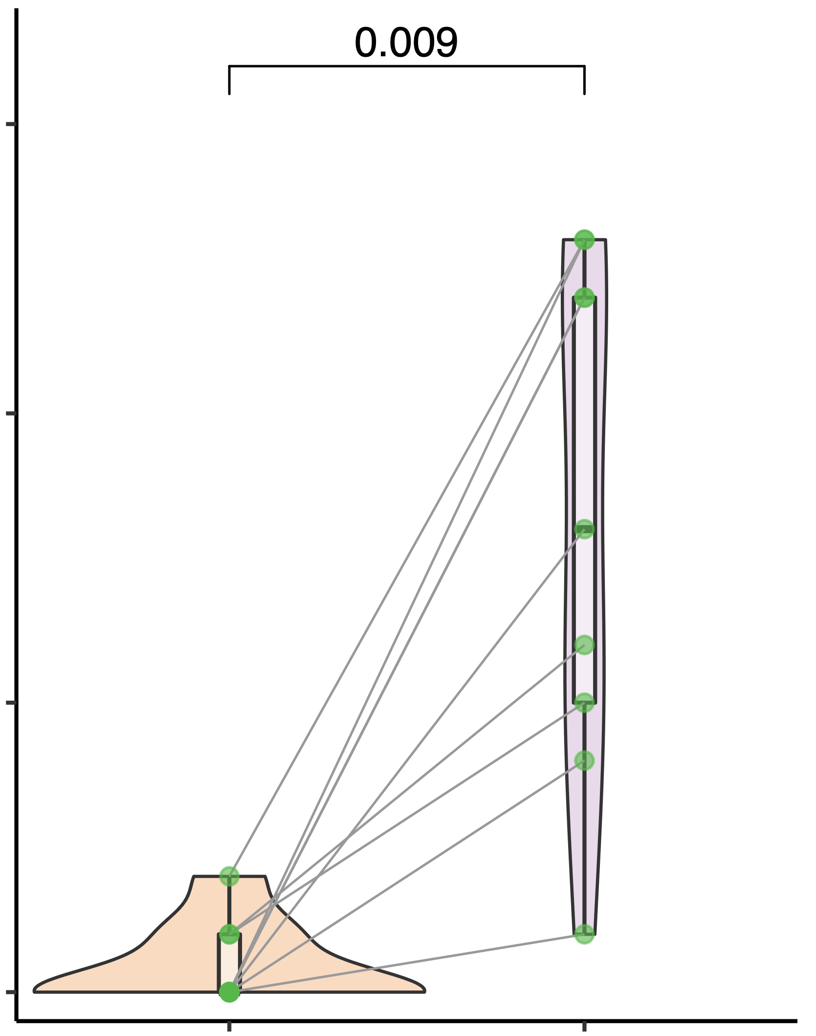
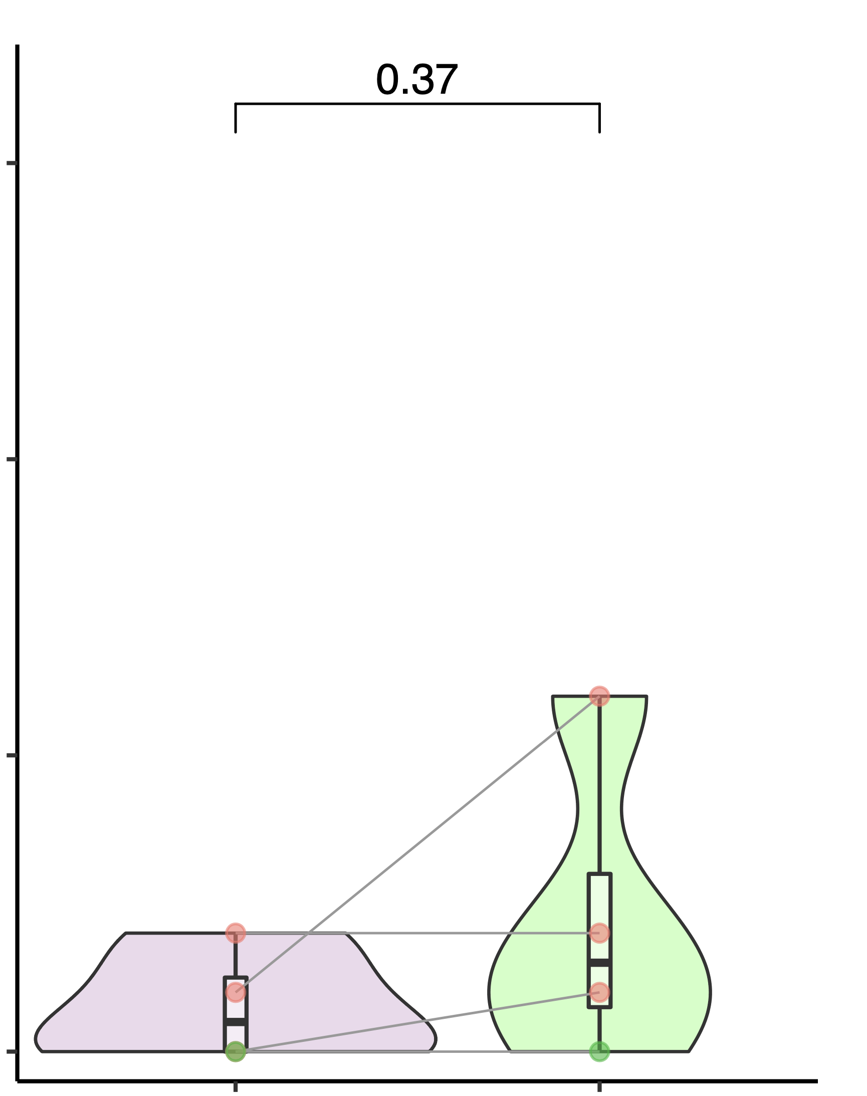
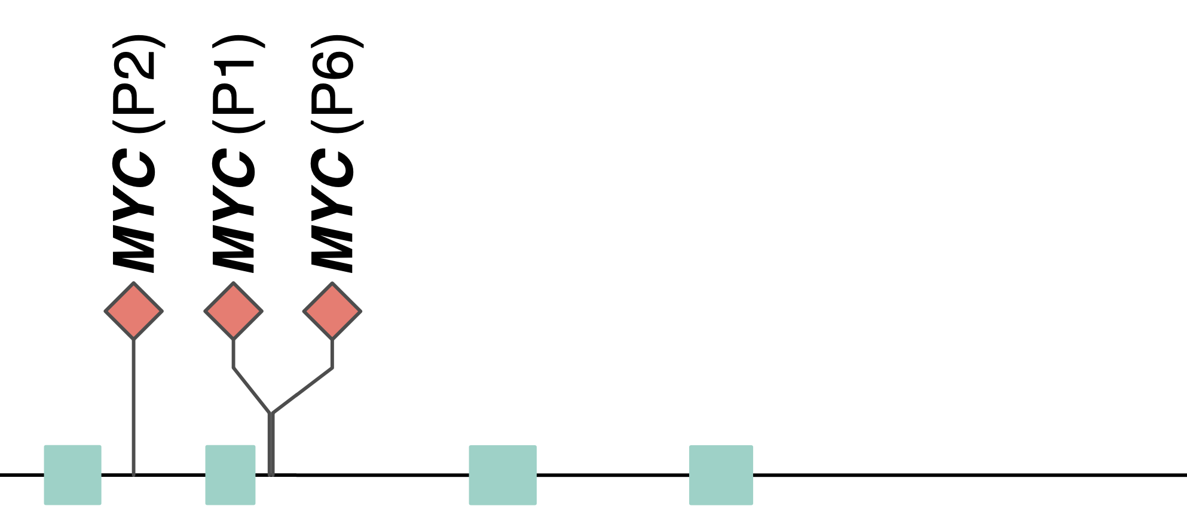
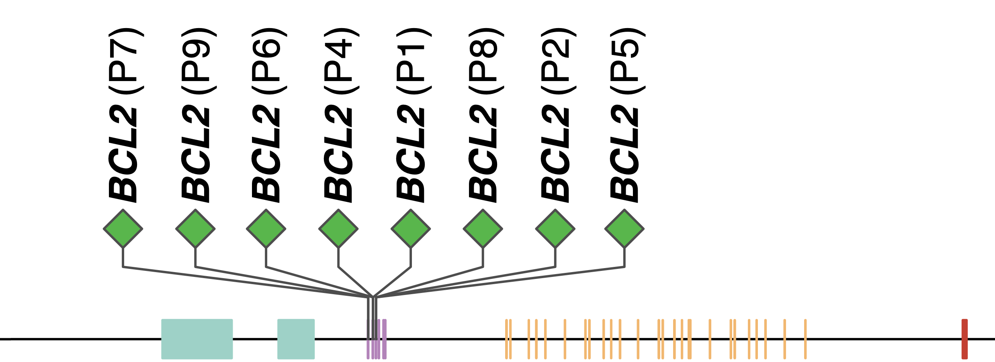
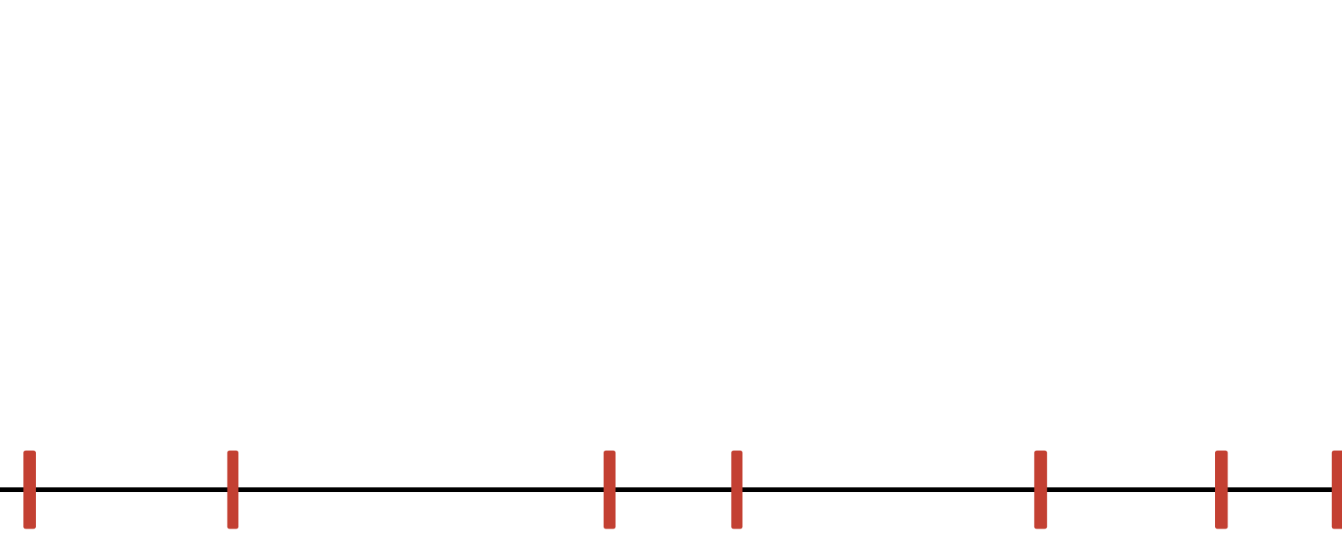

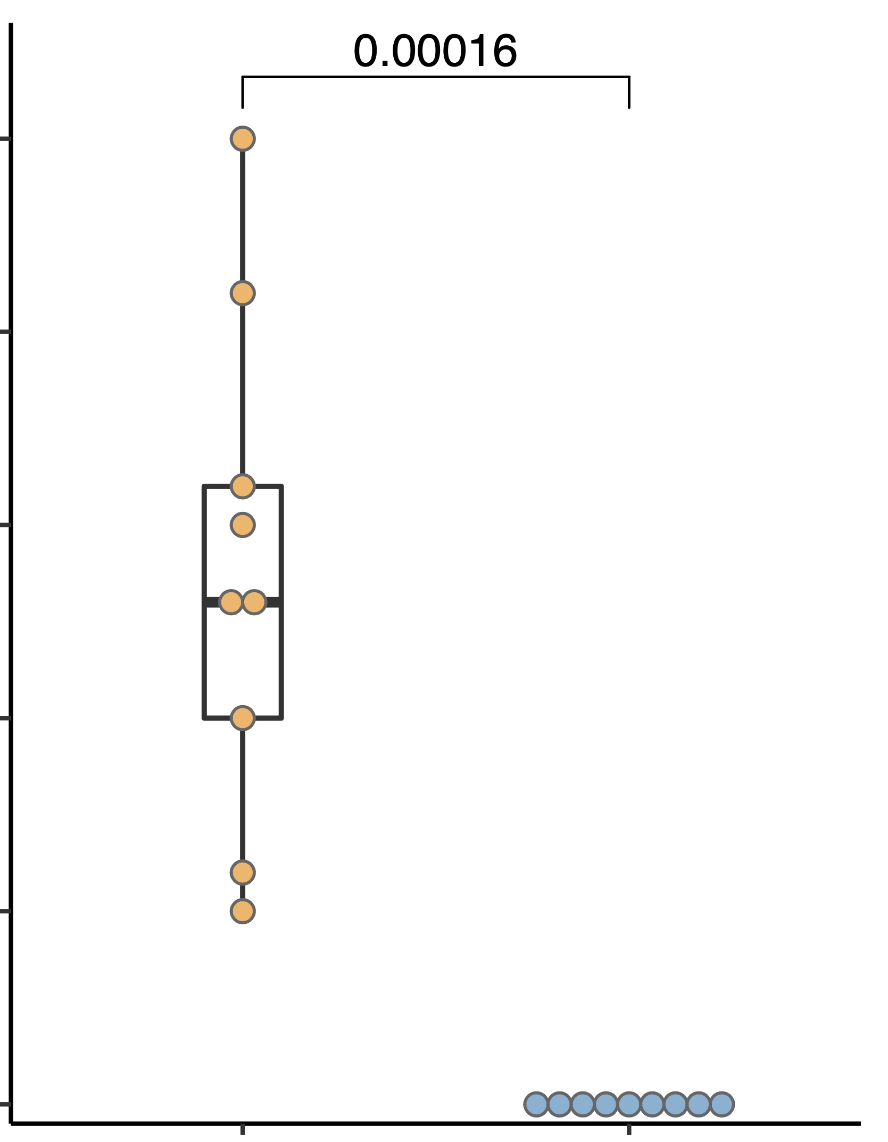
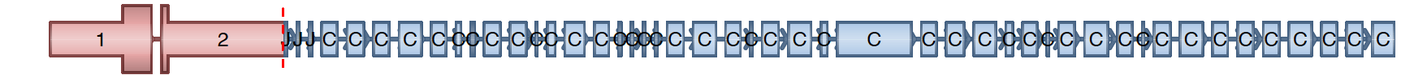
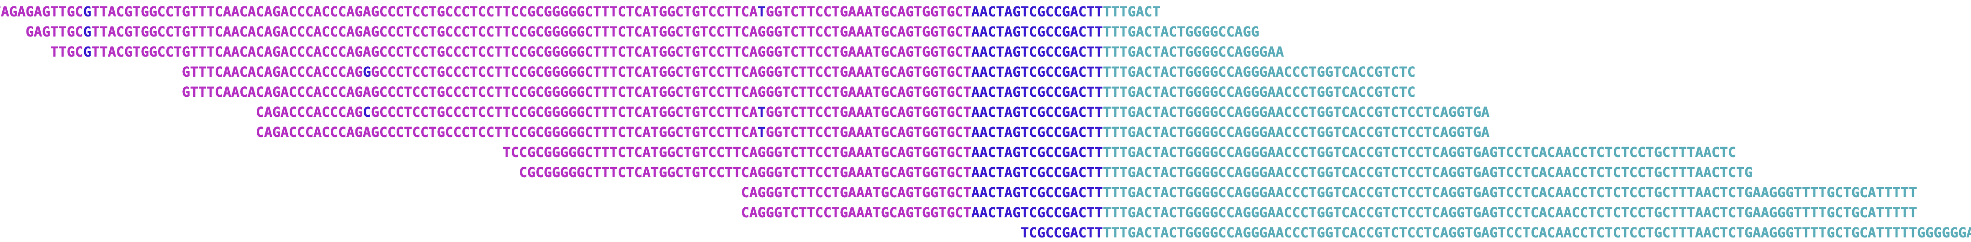
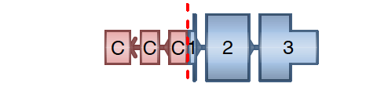
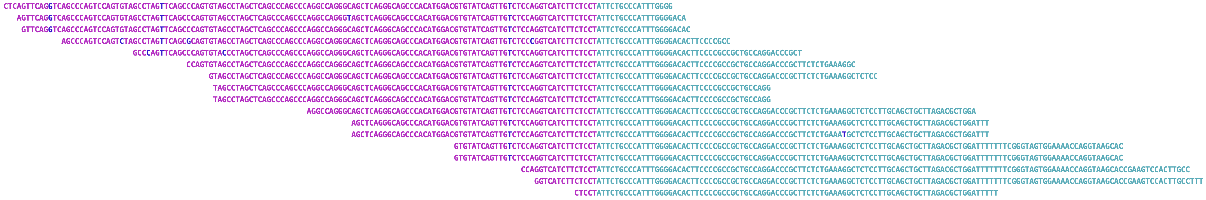
Supplementary Table 1. Clinical information of 8 DLBCL patients with FL to DHL transformation.
ID | Parents B | Patient B | Patient T | Diagnosis | Age | Gender | Race | Primary Site | Cohort
A
C
AID type break
AID type break
FL
DHL
chr18
BCL2
chr8
MYC
RAG type break
chr14
AID type break
chr14
IgH (J)
IgH S-region
15
p = 0.009
15
p = 0.37
10
10
Distance from nearest CpG site to breakpoint (bp)
Distance from nearest CpG site to breakpoint (bp)
5
5
0
BCL2
break point
IgH
break point
0
IgH
break point
MYC
break point
B
chr14
105836764
105939755
105591340
106810441
D
E
BCL2 — IgH fusion in P2.DHL tumor
Non-homologous end-joining of BCL2 --- IgH
p = 0.00016
5’-CTTTGACTACTGGGGCCAGG-3’
25
+
5’-GTGGTGCTTACGCTCCACCA-3’
20
5’-GTGGTGCTTAAGATGGTGGGGCCAGG-3’
DNTT induced template-independent break-end insertion in pre-B phases.
15
Length of break−end insertions (bp)
IgH — MYC fusion in P2.DHL tumor
Non-homologous end-joining of IgH --- MYC
10
5’-CGCGTCCCGCCCGCCTGTCC-3’
+
5’-CCACTTTAGCCTAGCTCAGC-3’
5
5’-CCACTTTAGCCCGCCTGTCC-3’
0
No break-end insertions in germinal center B stage.
BCL2
fusion
MYC
fusion
Extended Figure 1. BCL2 & MYC rearrangements detected in the tumor tissues of all eight patients .

Slide 2
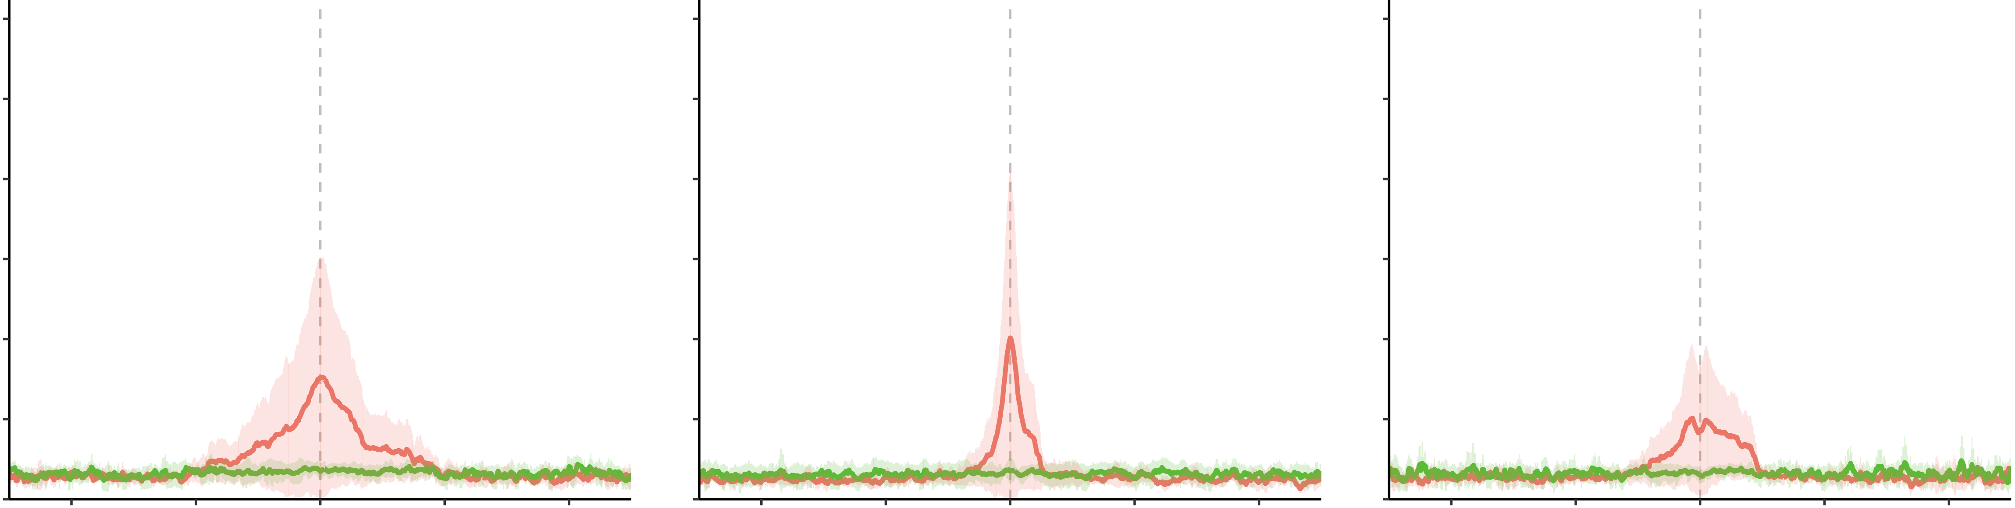
Supplementary Table 2. Somatic mutation table.
A
H3K27ac
H3K4me3
H3K4me1
0.6
0.6
0.6
FL
0.5
0.5
0.5
DHL
0.4
0.4
0.4
Normalized mutation density
0.3
0.3
0.3
0.2
0.2
0.2
0.1
0.1
0.1
0
-80kb
-40kb
0
40kb
80kb
0
-80kb
-40kb
0
40kb
80kb
0
-80kb
-40kb
0
40kb
80kb
Distance
Distance
Distance
Extended Figure 2. Germline copy number alterations and de novo germline mutations.
Supplementary Table 3. De novo germline mutations from 35 pGCT family trios

